Slide 1

Fakultas Ilmu Komputer
Learning is the process of acquiring new understanding, knowledge, behaviors, skills, values, attitudes, and preferences.
Framework #7-2
[Model & Database Query]

Slide 2

Welcome to the Framework Programming course

Slide 3

1 – Create Core Controller Class

Slide 4
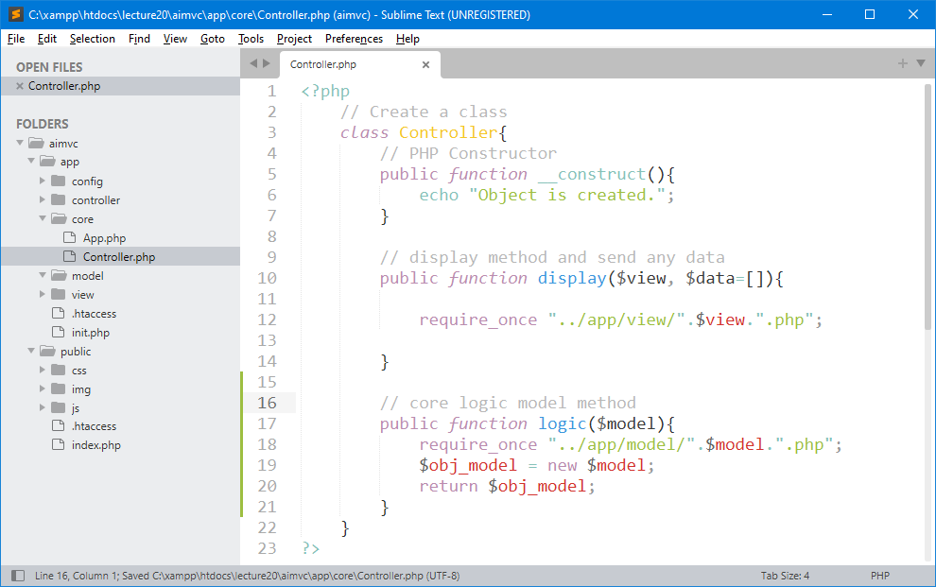
1 - Create Core Logic Method
Model component stores data and its related logic.

Slide 5
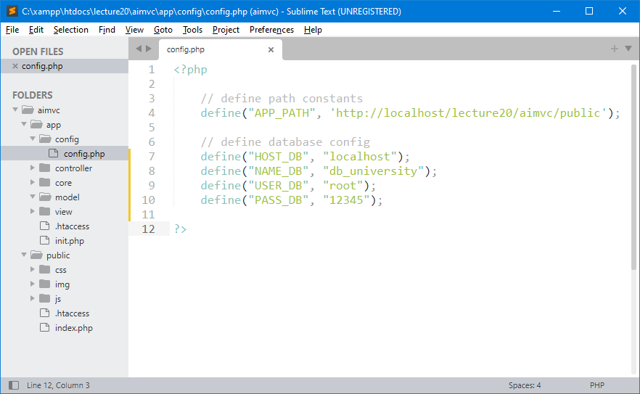
2 - Config a Connection to MySQL

Slide 6
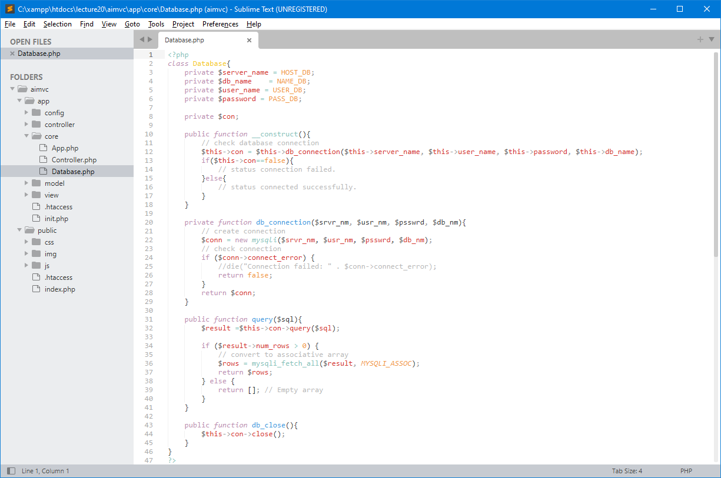
3 - Create Code Database Connection

Slide 7
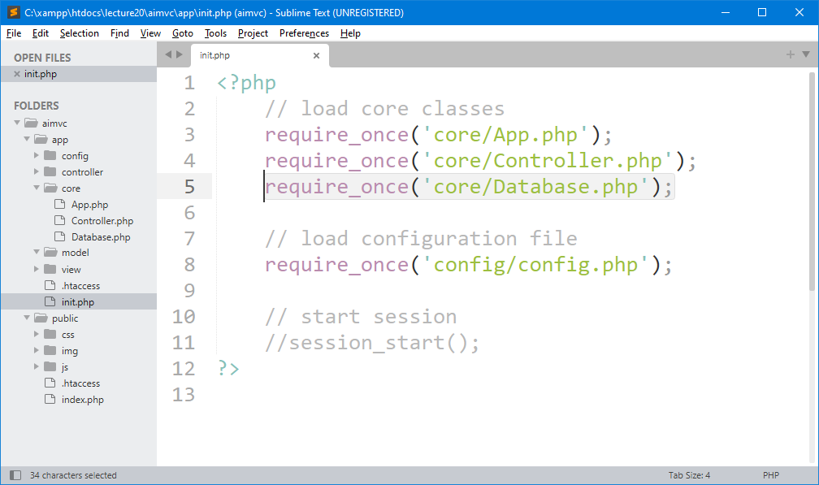
4 – Manage Core Database.php in init.php

Slide 8
2 – Create Model component to store data and its related logic.

Slide 9
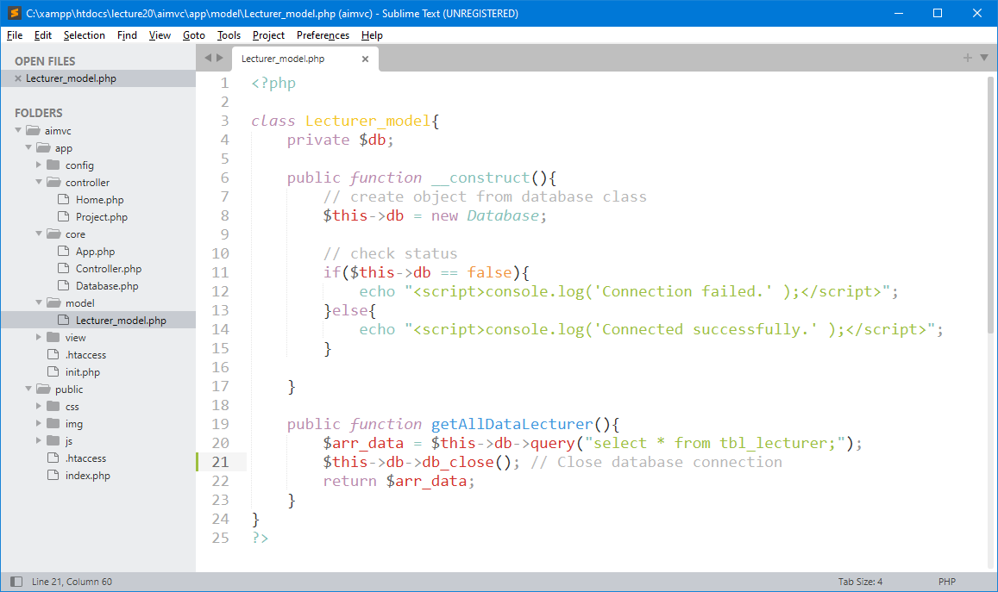
1 – Create Model Component (Lecturer_model)
Create model component with related logic and get the data from database.

Slide 10
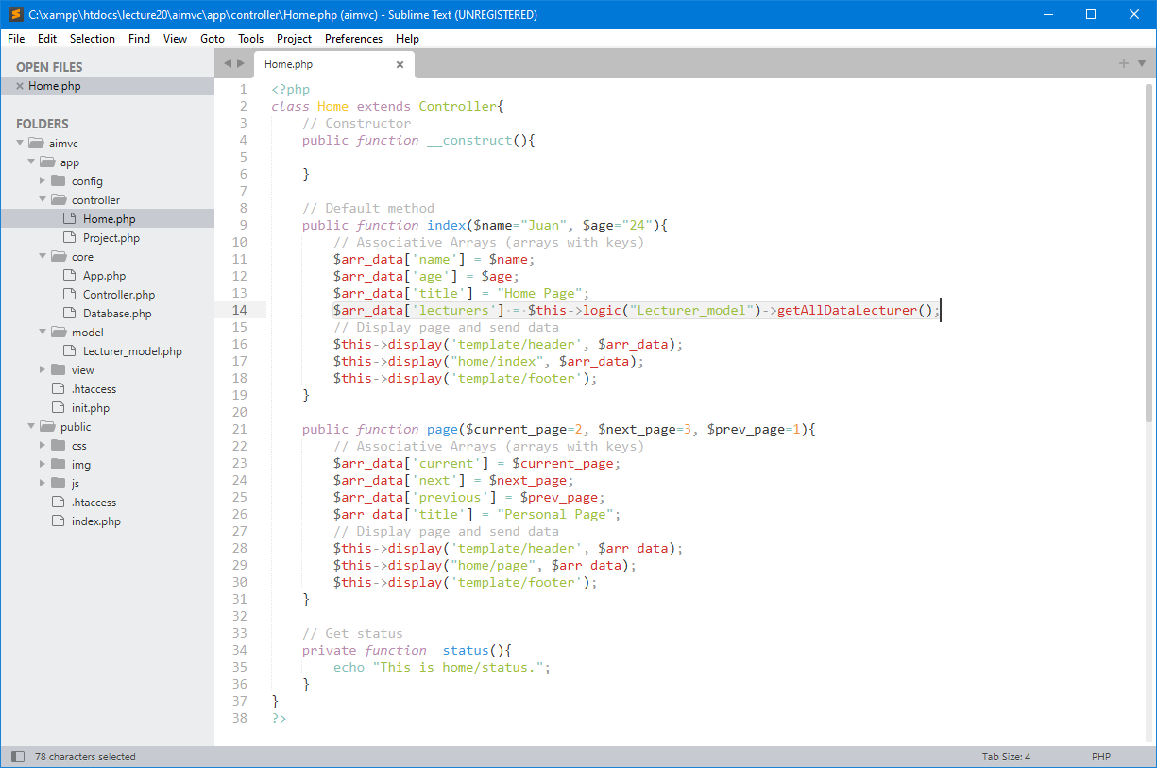
2 – How to Read the data from Controller?

Slide 11
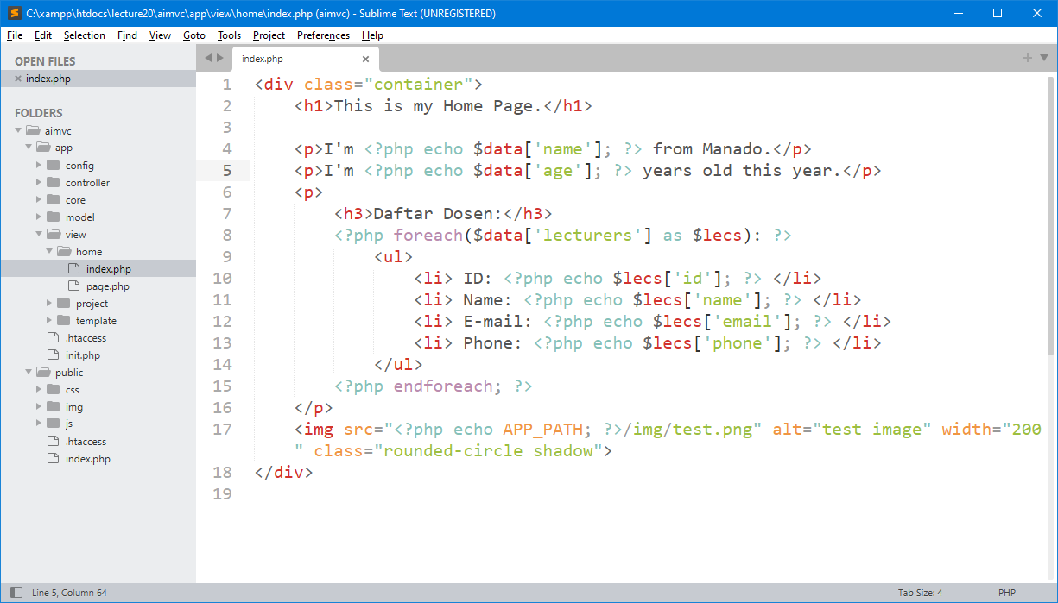
3 – Modify Code in /view/home/index.php

Slide 12
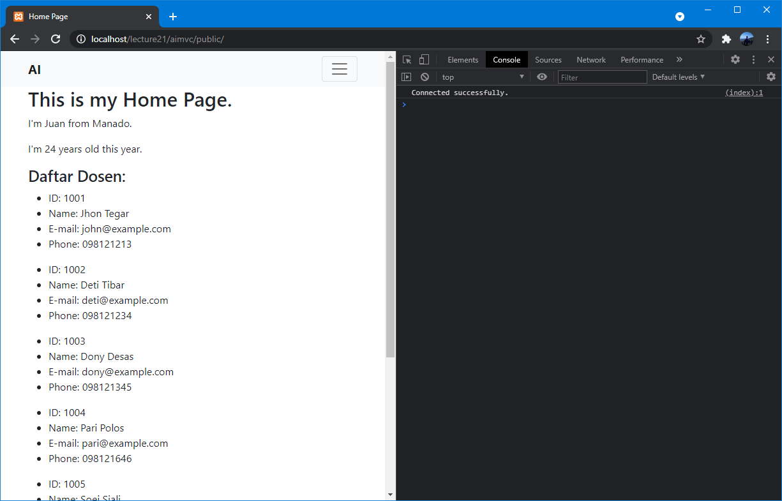
4 – Testing View Data from Database

Slide 13

exercise for students

Slide 14
Latihan untuk Students
Create directory : C:\xampp\htdocs\lecture21\
Create file : _.php
Buat semua contoh yang sudah di pelajari sebelumnya di lecture ini.

Slide 15

THANK YOU
END PRESENTATION
Thank you for your attention
Instructor: S – W – T

Slide 16
References
XAMPP phpMyAdmin: How to Create Database and Tables
https://blog.templatetoaster.com/xampp-phpmyadmin/
Unable to login to phpMyAdmin in XAMPP
https://techubber.blogspot.com/2017/11/phpmyadmin-access-denied-user-root-no-password-unable-login-phpmyadmin.html
Creating MySQL Database with XAMPP
https://www.javatpoint.com/creating-mysql-database-with-xampp
How to create a database using phpMyAdmin and XAMPP
https://skillforge.com/how-to-create-a-database-using-phpmyadmin-xampp/
Mengubah Password Root Pada phpMyAdmin
https://jagowebdev.com/mengubah-password-root-mysql-dengan-phpmyadmin/
PHP MySQL Database
https://www.w3schools.com/php/php_mysql_select.asp

